Slide 1
IGN Video game reviews
Ellen A. Savoye
July 12, 2018

Slide 2
Approach
Background
Caveats
The Data
Exploratory Analysis
Predictive Models
Conclusions
Recommendations

Slide 3
Background
20 years of video games
What is IGN
Where does the underlying data come from?
What is the purpose of this study?

Slide 4
Caveats
Lack of financial data
Multiple console games

Slide 5
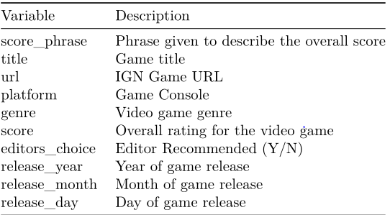
The Data
Data overview
10 original columns
18,625 records
Outliers
“The Walking Dead: The Game – Episode 1: A New Day”
Consolidating Fields
Genre (113 21)
Platform (59 14)

Slide 6
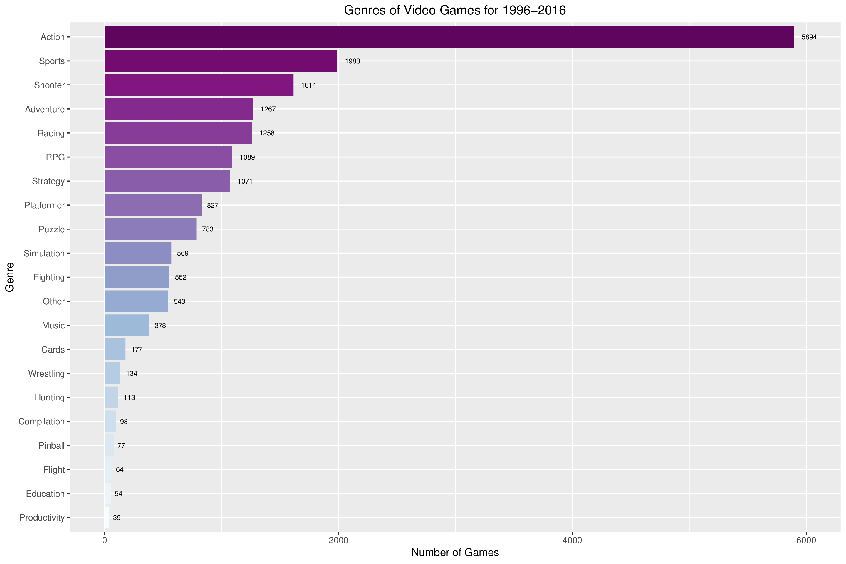
Exploratory analysis (genre)
Cumulatively, the “Action” genre is more than double the next highest genre, “Sports”

Slide 7
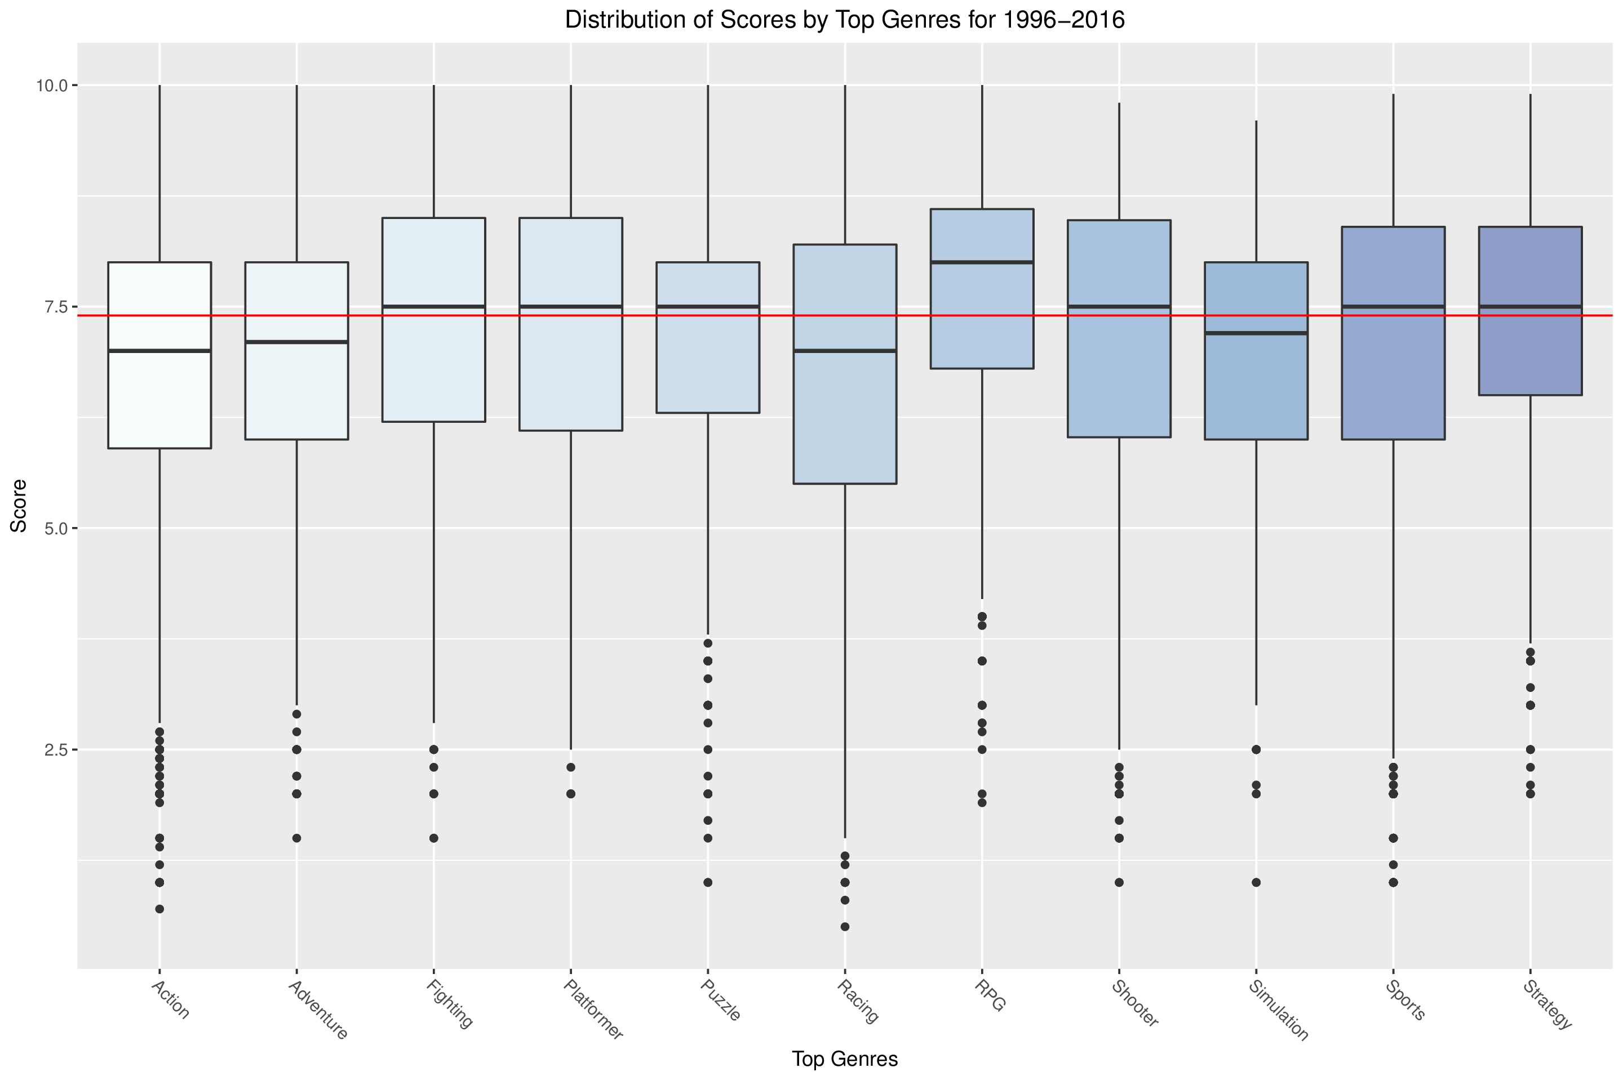
Exploratory analysis (genre Cont.)
550 is the minimum for “Top Genres”
Excluding the catch-all “Other”
RPG – higher ratings overall compared to others
Racing – largest range of scores
Action – even though it has the most volume, the scores are in line with other genres with less volume: i.e., Adventure, Puzzle, Simulation

Slide 8
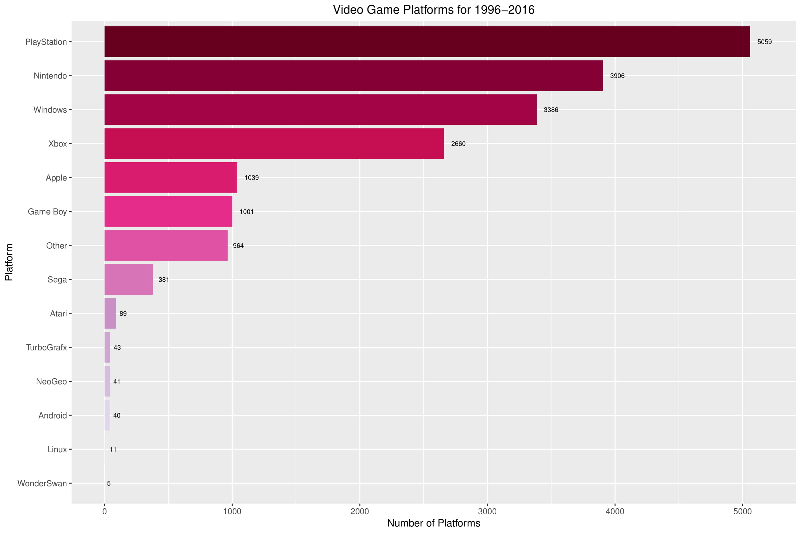
Exploratory analysis (Platform)
Platform evolution have been grouped
PlayStation is top of the video game quantity market even though it launched after Nintendo

Slide 9
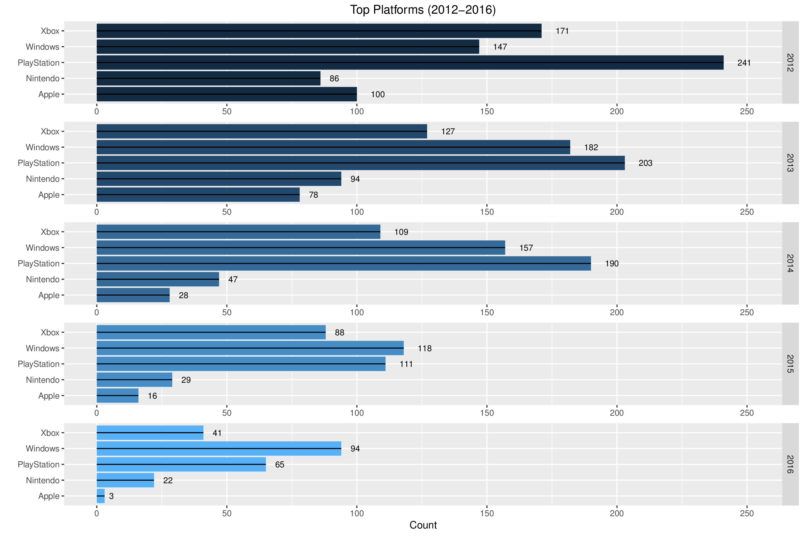
Exploratory analysis (Platform Cont.)
Last 5 years for top 5 systems
2012-2014: PlayStation is the clear leader, consistent with all years combined
2015-2016: Windows is the top platform
Shift towards more computer based games
Better graphics, more customization

Slide 10
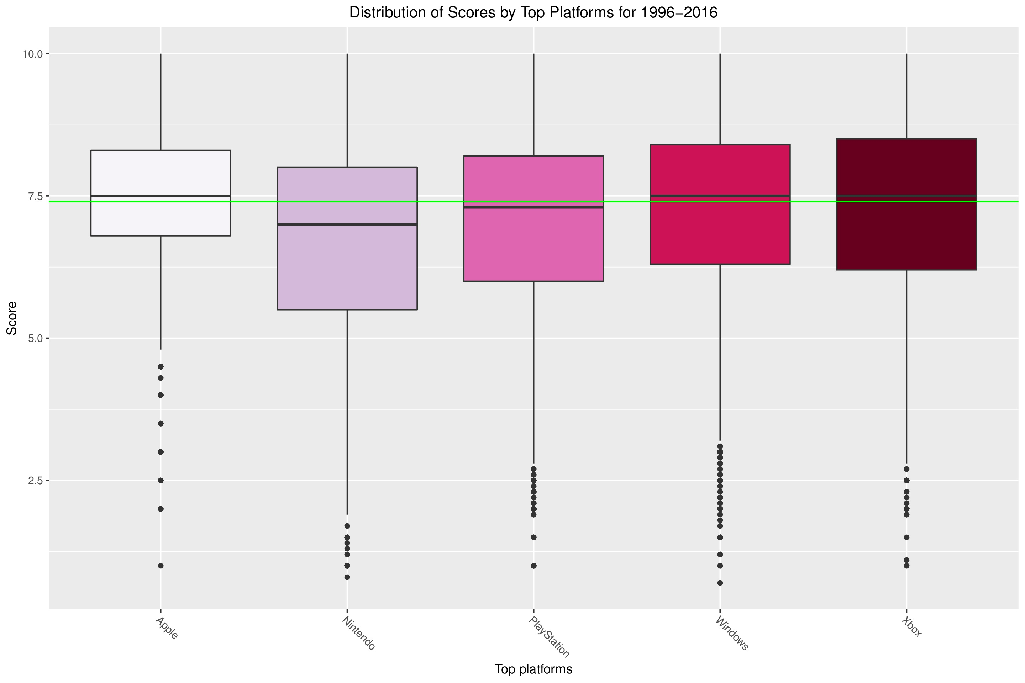
Exploratory analysis (Platform Cont.)
Xbox and Windows have higher overall scores (25th, 50th, and 75th IQR)
Nintendo has lower scores on average when compared with other top four platforms

Slide 11
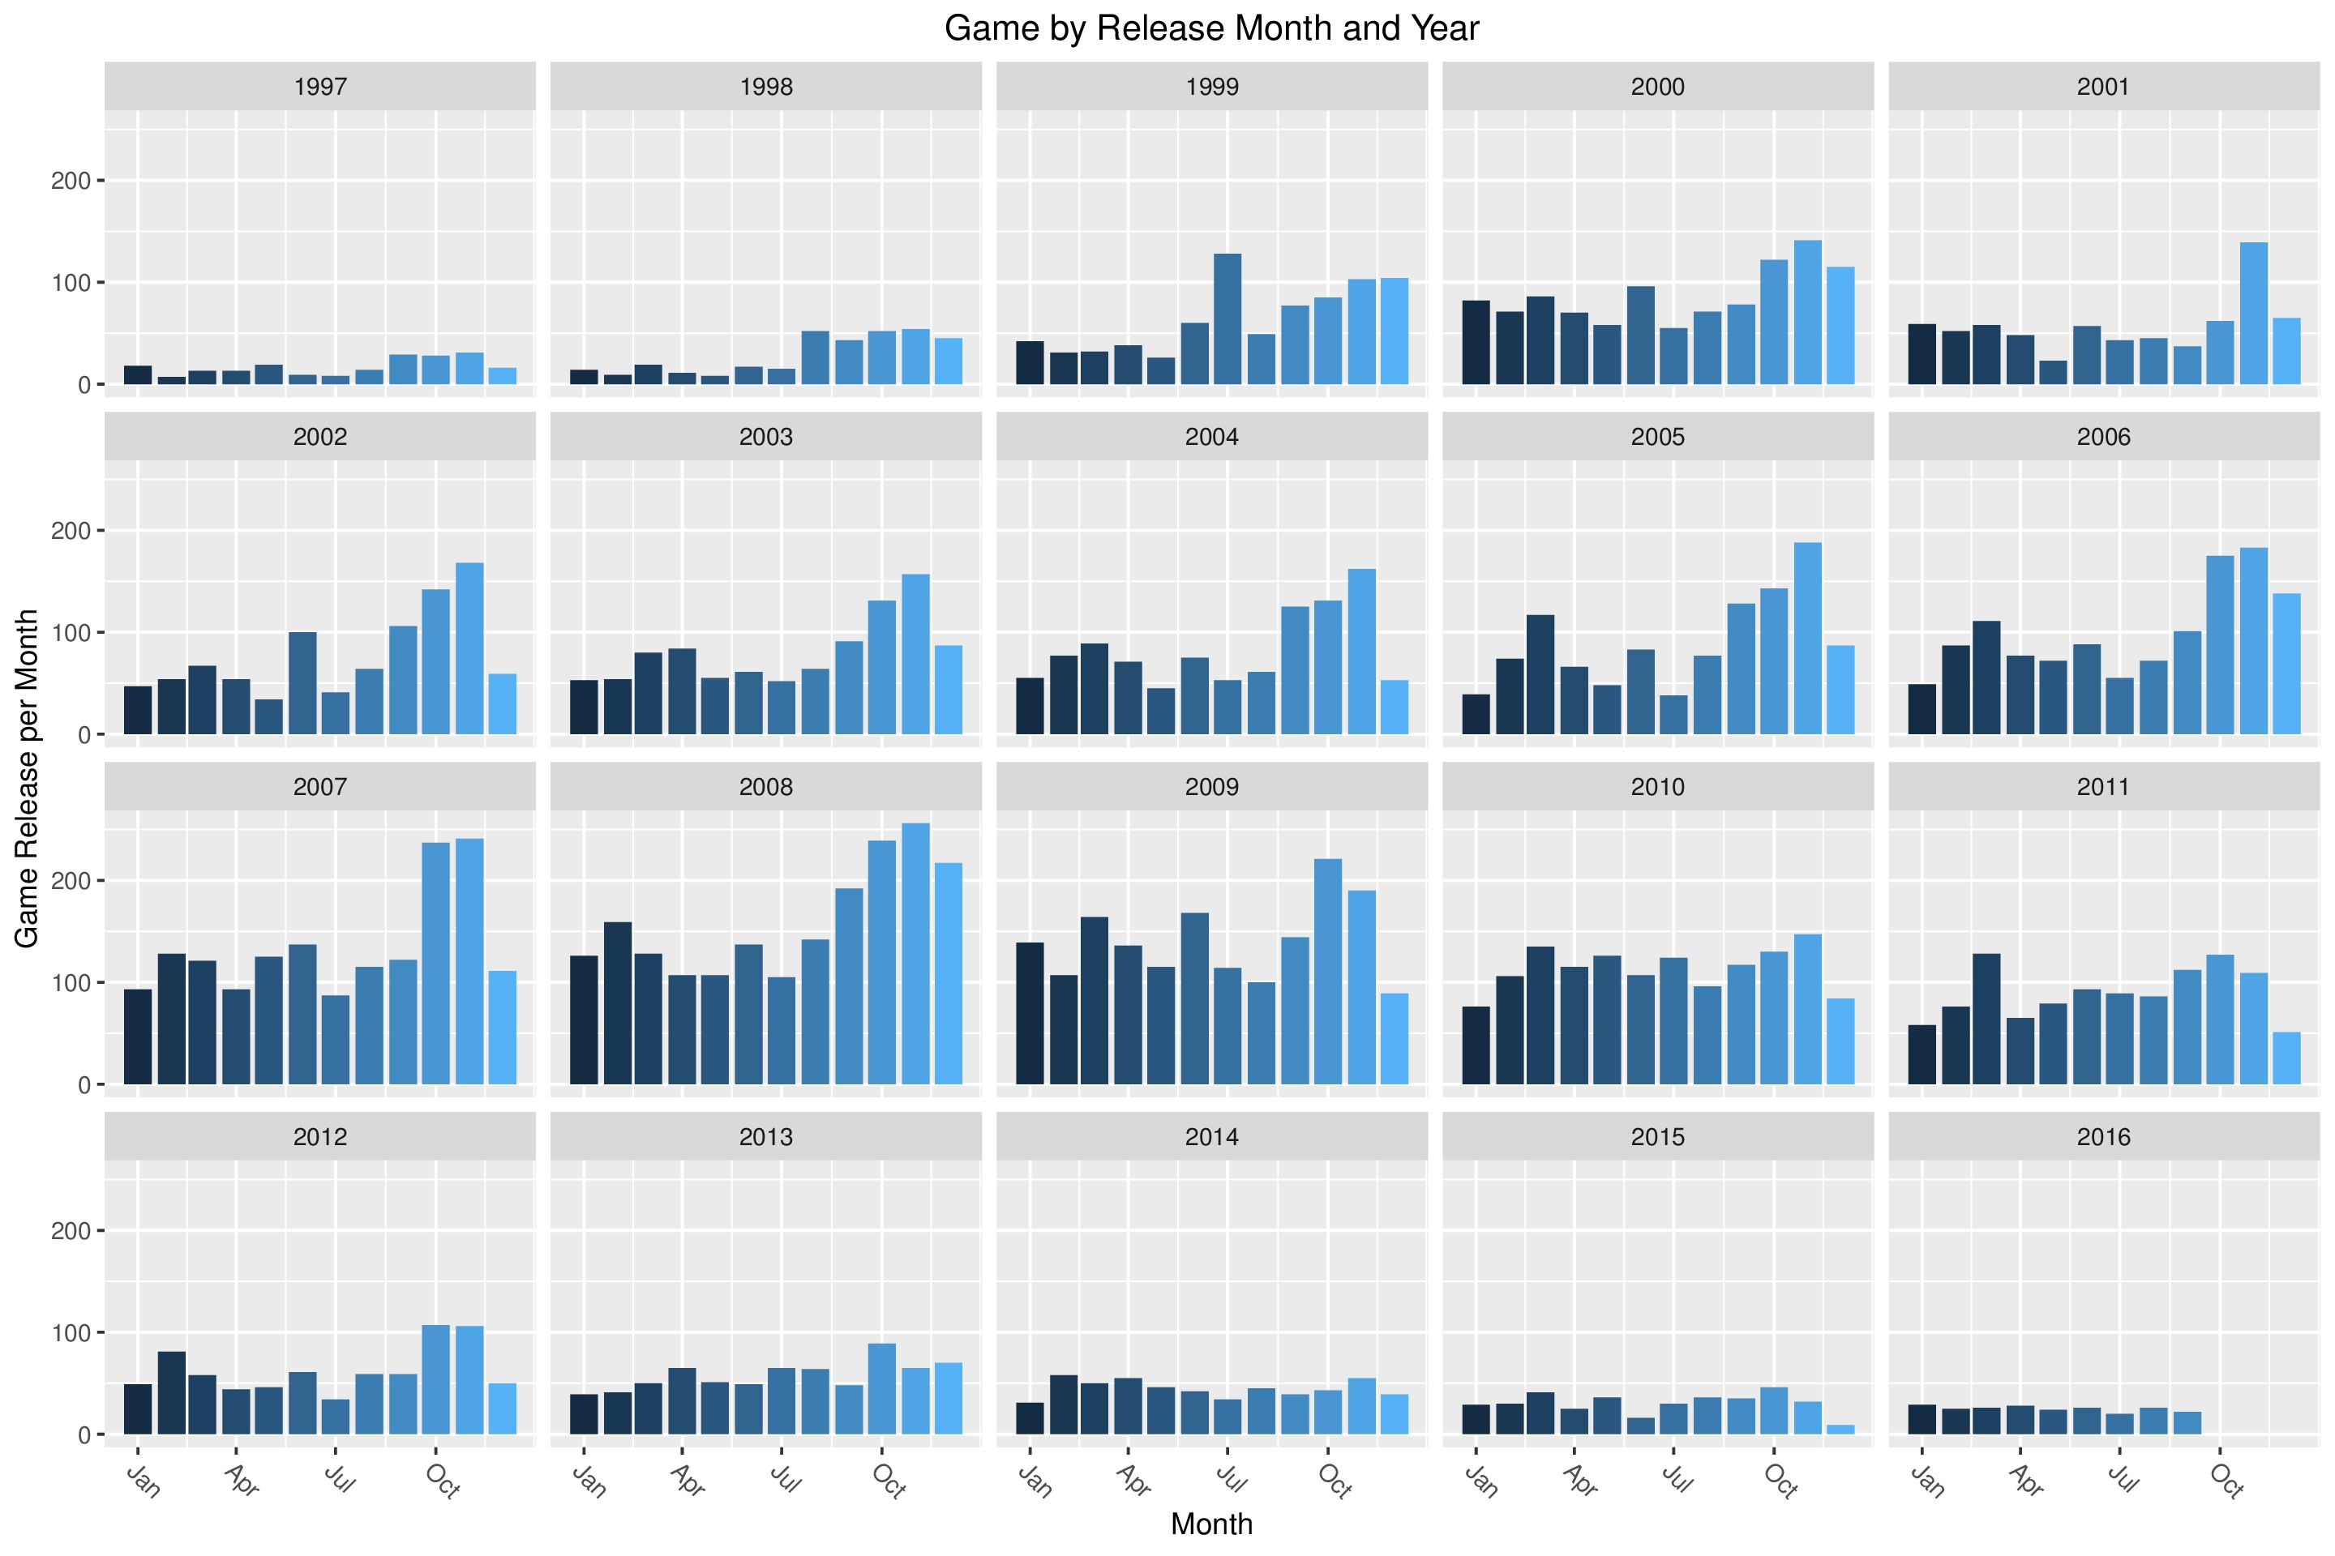
Exploratory analysis (Dates)
Number of games released yearly increases until 2008 (year with most reviewed and published)
October and November were the preferred release month for historical releases
Decrease in quantity of games could be due to more intricate storylines and elaborate graphics

Slide 12
Predictive Models (Data)
Subset the data
Remove blank records (36 records)
Predictive models cannot run with blank records
Binary/Dummy variables for categorical data

Slide 13
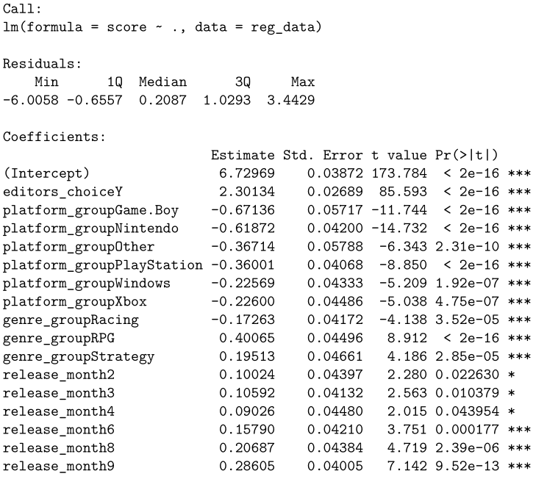
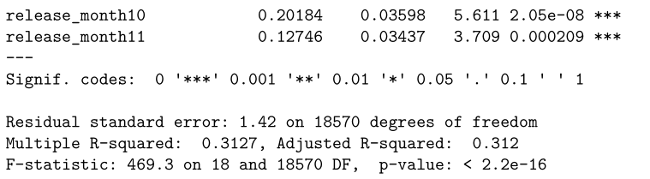
Predictive Models (linear regression)
3 iterations
Removed high collinearity (multicollinearity)
Insignificant fields
R-squared: 31.27%

Slide 14
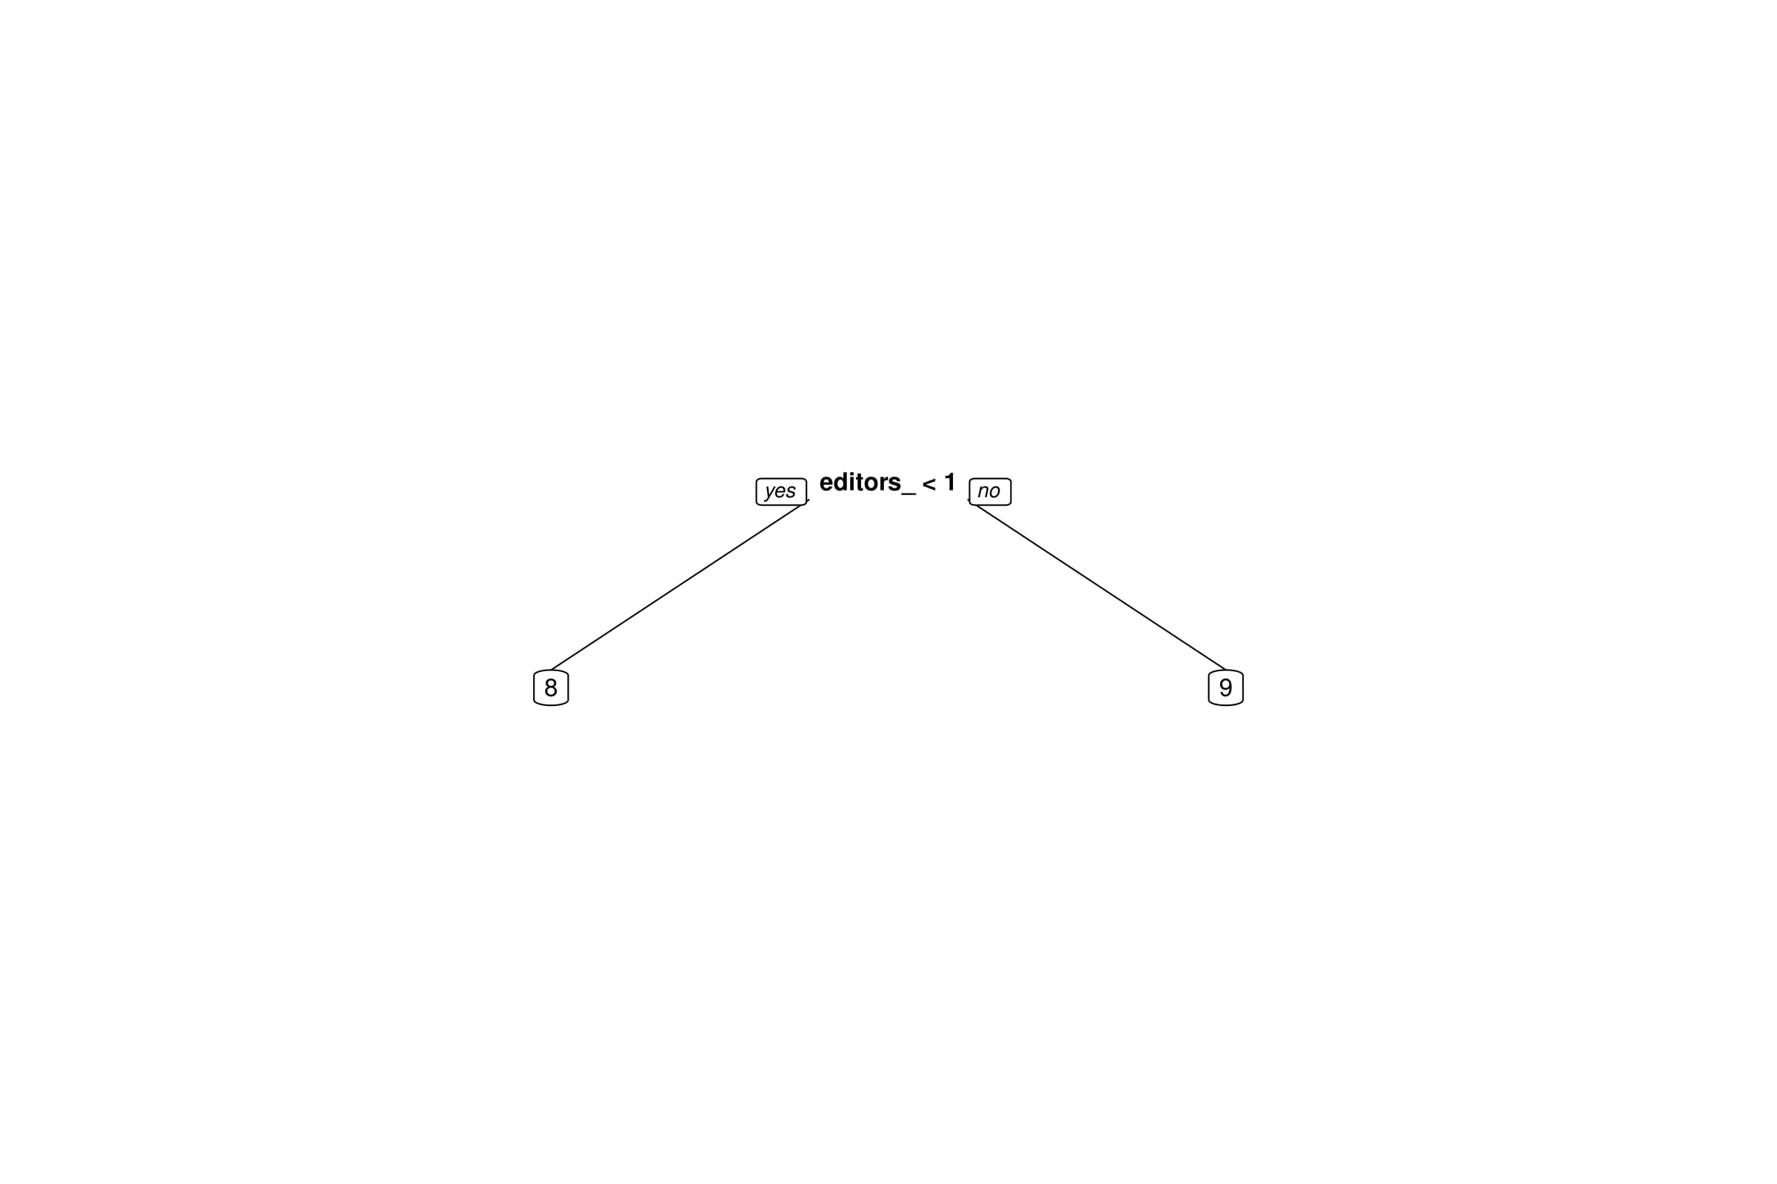
Predictive Models (CART Model 1)
Only one node
Editor’s choice has greatest determination of score
R-Squared: 30.4%
Linear regression is better

Slide 15
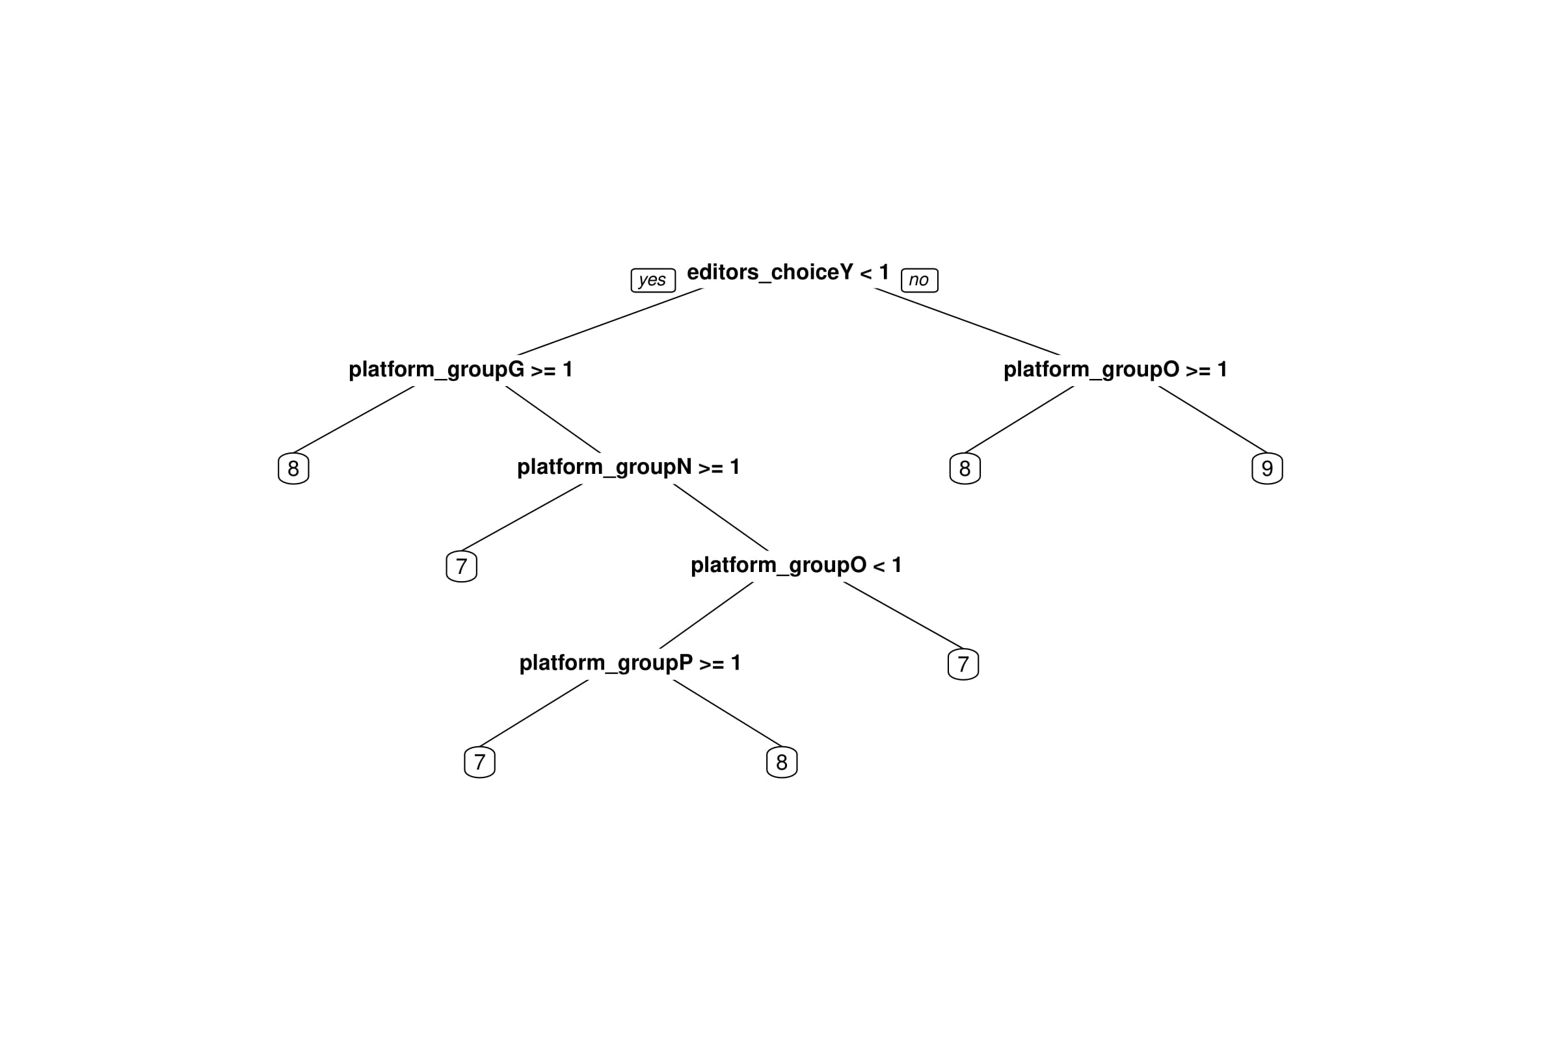
Predictive Models (CART Model 2)
Forced multiple nodes
Editor’s choice still has greatest determination of score

Slide 16
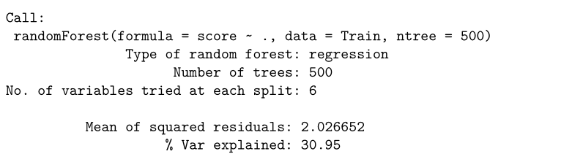
Predictive Models (Random forest)
Selects data randomly and with replacement
R-squared: 32.69%
Better than both linear regression and CART models

Slide 17
Conclusions/limitations
Conclusions
Low R-squared, significant predictors
While specific platforms are significant in the models, relationship is negative
Genre RPG and Strategy and release months have positive relationship
Human factor/opinion in scores
Pose a challenge when creating a precise model
Limitations
Human factor
Lack of detail behind score determination
Graphics
Storyline
Etc.

Slide 18
Recommendations
Additional study incorporating information regarding the following:
Score determination
Financial data
Sales volume
Cost of each game
Demographics of buyers (if available)

